Slide 1
Using two-way tables to display outcomes for two events
Probability: possible outcomes

Slide 2
How our teaching resources are designed for the classroom

Slide 3
I can systematically find all the possible outcomes for two events by using a two-way table.

Slide 4
An outcome table is a table that shows all the possible outcomes.

Slide 5

Using two-way tables to display outcomes for two events
Outcome table from a two-stage trial
Outcome table from two events
Frequency in a two-way table

Slide 6
Outcome table from a two-stage trial
If we were to spin this spinner twice, what are the possible outcomes?
We can make an outcome table to determine the possible outcomes.
spin 1
win
lose
The columns will be the outcomes from spin 1.
win
lose
win, win
lose, win
The rows will be outcomes from spin 2.
win
spin 2
win, lose
lose, lose
lose

Slide 7
Outcome table from a two-stage trial
If we were to spin this spinner twice, what are the possible outcomes?
An outcome table will help determine the possible outcomes.
lose
draw
win
lose
spin 1
win
win
lose
draw
win, win
lose, win
draw, win
win
win, lose
lose, lose
draw, lose
spin 2
lose
win, draw
lose, draw
draw, draw
draw

Slide 8
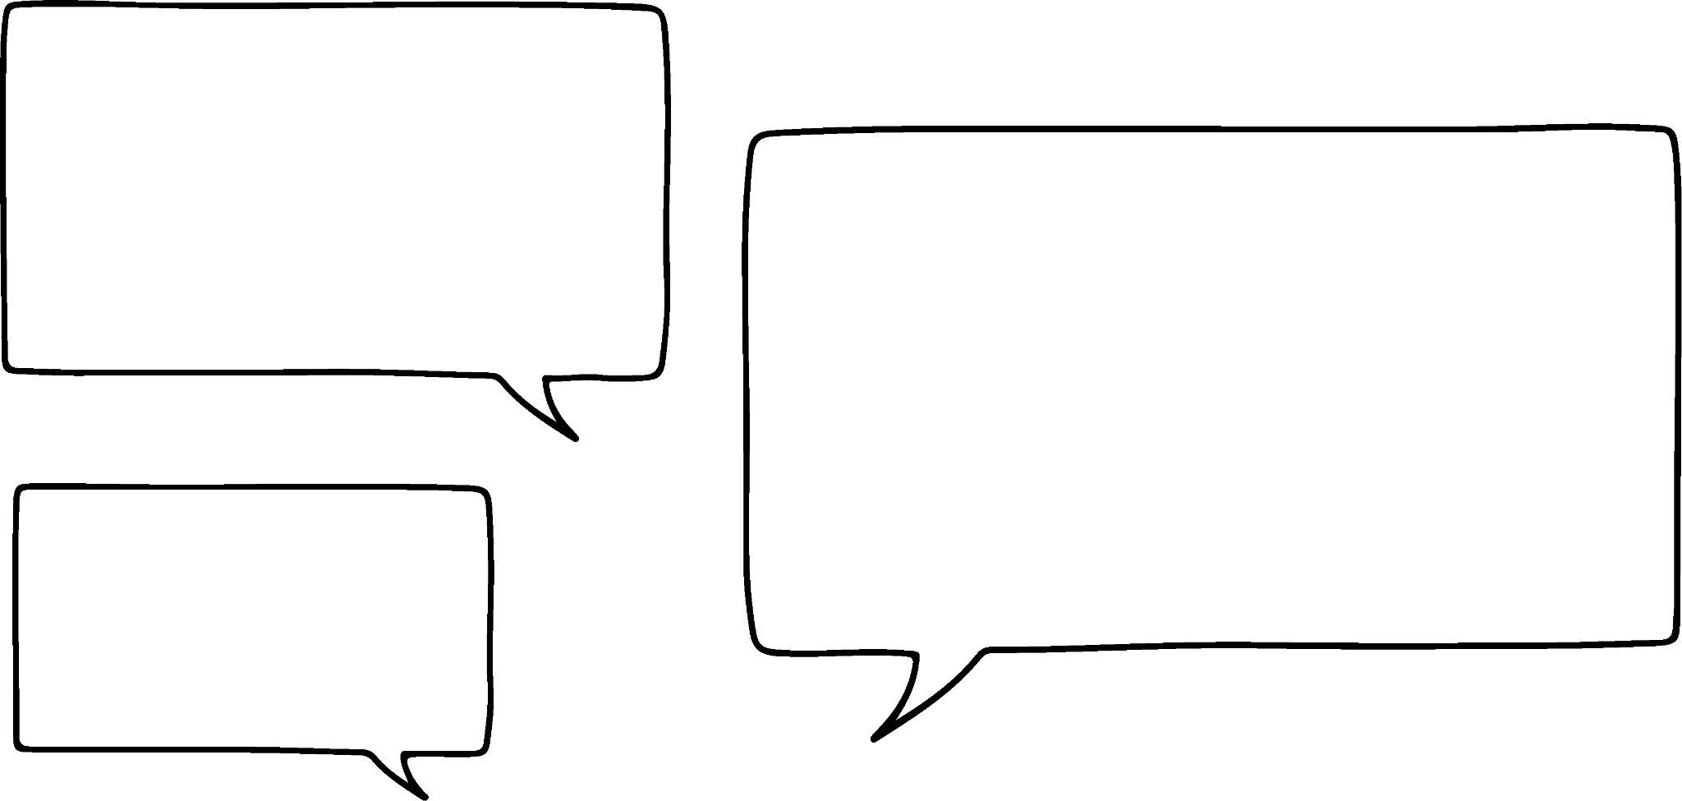
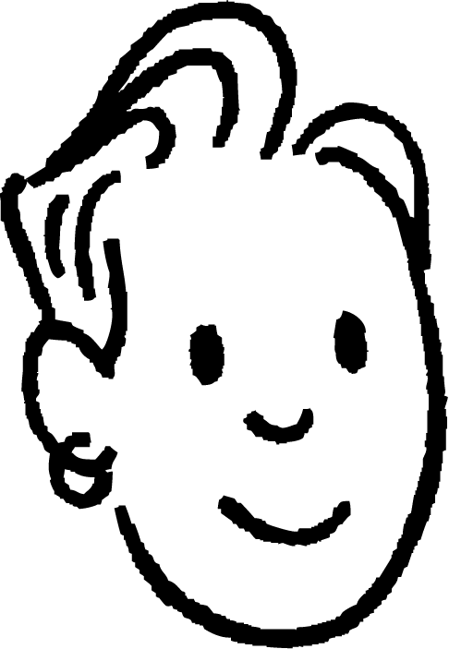
Outcome table from a two-stage trial
A trial is to spin both spinners.
We can make an outcome table to show the possible outcomes.
C
A
B
spinner 1
1
4
A
B
C
Does it matter which spinner was ‘spinner 1’?
2
3
1
A1
B1
C1
2
A2
B2
C2
spinner 2
3
A3
B3
C3
In this case, no. A1 and 1A are the same outcome.
4
A4
B4
C4
Sam

Slide 9


Outcome table from a two-stage trial
Which of the following could be an outcome table for these two spinners?
1
3
A
D
2
B
C
b
c
a
1
2
3
1
B
3
1
2
3
A
1A
2A
3A
A
1A
BA
3A
A
B
1B
2B
3B
2
12
B2
32
A1
B1
C1
D1
B
C
1C
2C
3C
C
1C
BC
3C
A2
B2
C2
D2
C
A3
B3
C3
D3
D
1D
2D
3D
D
1D
BD
3D
D

Slide 10
Outcome table from a two-stage trial
A game is being played where the highest spin wins.
Sofia and Jun play the game, they both have a spinner.
1
2
3
Sofia
Both of these outcomes are one spinner with a ‘1’ and the other with a ‘2’.
1
2
3
no win
Sofia wins
Sofia wins
1
Jun wins
no win
Sofia wins
However, the allocation of the number to a person is now important, to determine who wins.
Jun
2
Jun wins
Jun wins
no win
3

Slide 11
Outcome table from a two-stage trial
A game is being played where the total from the two spins of this spinner determines the number of counters collected.
An outcome table can show the possible totals, which allows you to see the likelihood of receiving that number of counters.
5
1
4
2
3
spin 1
The possible number of counters are {2, 3, 4, 5, 6, 7, 8, 9, 10}
1
2
3
4
5
1
2
3
4
5
6
2
3
4
5
6
7
These outcomes are not equally likely to each other.
spin 2
3
4
5
6
7
8
4
5
6
7
8
9
5
6
7
8
9
10

Slide 12
Outcome table from a two-stage trial
The two spinners are going to be spun and the numbers will be multiplied together. Complete the outcome table.
1
2
4
6
4
5
6
3
5
1
4
8
12
2
5
10
15
3
6
12
18

Slide 13
Outcome table from a two-stage trial
1) This spinner is going to be spun twice as part of a two-stage trial. Complete the outcome table to show all the possible outcomes.
A
B
C
A
C
A
B
B
C

Slide 14
Outcome table from a two-stage trial
2) Both spinners are going to be spun as part of a two-stage trial. Complete the outcome table to show all the possible outcomes.
1
2
A
C
A
B
1
2
B
C

Slide 15
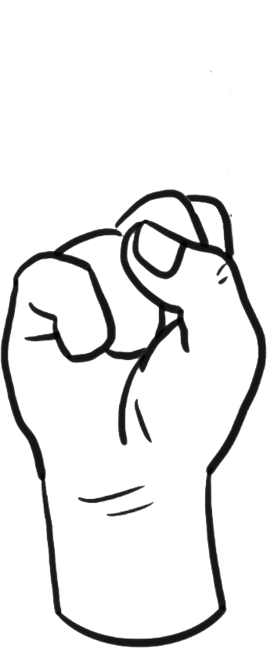
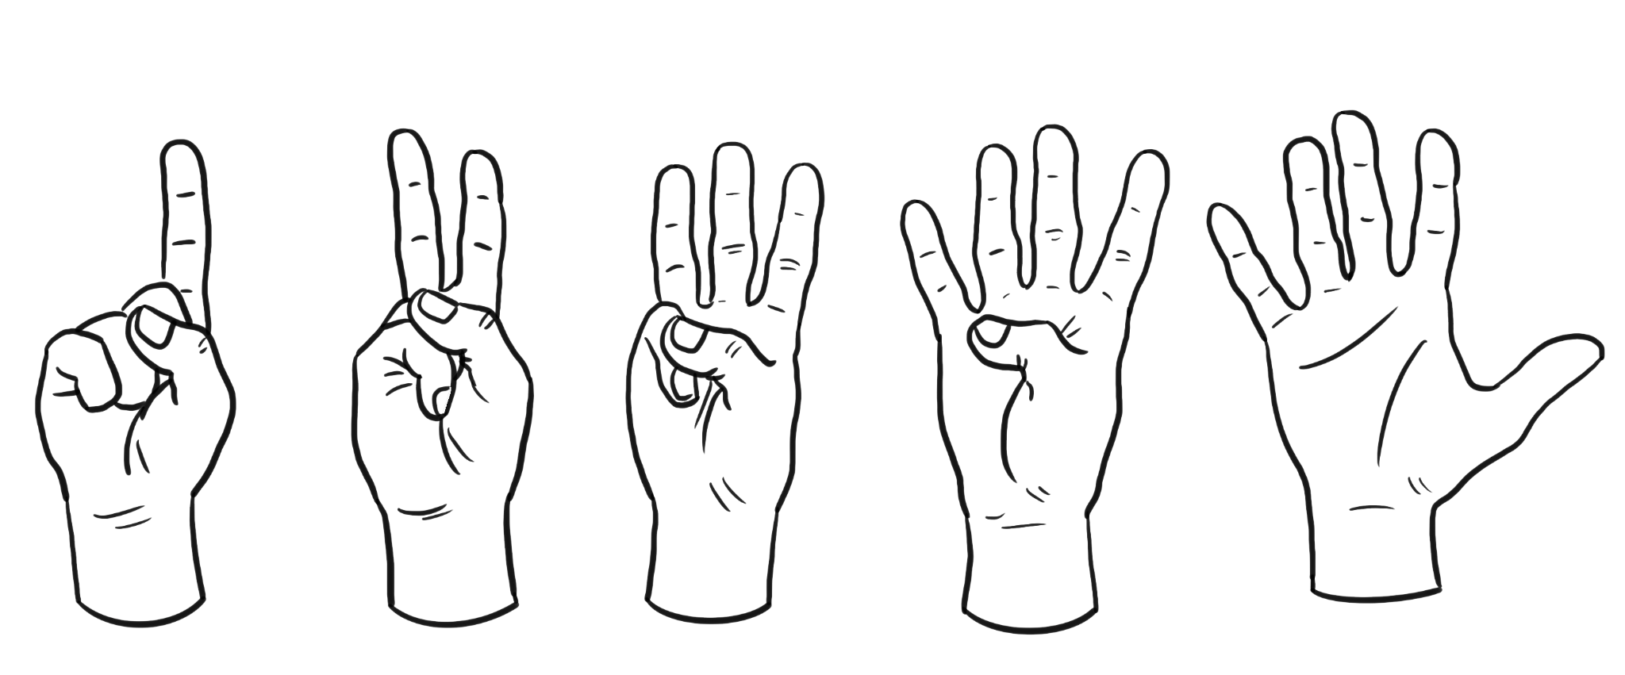
Outcome table from a two-stage trial
3) Laura and Izzy are playing a game of ‘rock, paper, scissors’, where rock beats scissors, scissors beats paper and paper beats rock.
Complete the outcome table to show when each person wins.
Laura
rock
paper
scissors
1
2
rock
Izzy
paper
scissors

Slide 16
Outcome table from a two-stage trial
1) This spinner is going to be spun twice as part of a two-stage trial. Complete the outcome table to show all the possible outcomes.
A
B
C
A
C
A
AA
AB
AC
B
B
BA
BB
BC
C
CA
CB
CC

Slide 17
Outcome table from a two-stage trial
2) Both spinners are going to be spun as part of a two-stage trial. Complete the outcome table to show all the possible outcomes.
1
2
A
C
A
A1
A2
B
1
2
B
B1
B2
C
C1
C2

Slide 18
Outcome table from a two-stage trial
3) Laura and Izzy are playing a game of ‘rock, paper, scissors’, where rock beats scissors, scissors beats paper and paper beats rock.
Complete the outcome table to show when each person wins.
Laura
rock
paper
scissors
1
2
rock
no one
Laura
Izzy
Izzy
paper
Izzy
no one
Laura
scissors
Laura
Izzy
no one

Slide 19
Using two-way tables to display outcomes for two events
Outcome table from a two-stage trial
Outcome table from two events
Frequency in a two-way table

Slide 20
Outcome table from two events
If this spinner is spun the possible outcomes are {1, 2, 3, 4, 5}.
Izzy and Lucas are playing a game. Izzy gets a point if it lands on a prime number and Lucas gets a point if it lands on an odd number.
5
1
4
2
3
An outcome table can be set up to categorise the possible outcomes.
not a prime number
prime number
odd number
3
1
5
not an odd number (even)
2
4

Slide 21
Outcome table from two events
If this spinner is spun the possible outcomes are {1, 2, 3, 4, 5}.
Izzy and Lucas are playing a game. Izzy gets a point if it lands on a prime number and Lucas gets a point if it lands on an odd number.
5
1
4
2
3
All possible outcomes, the sample space, are represented in the outcome table.
not a prime number
prime number
odd number
3
1
5
not an odd number (even)
2
4

Slide 22
Outcome table from two events
Izzy and Lucas decide to change the rules of their game. Izzy now gets a point if the spinner lands on ‘an even number’ and Lucas gets a point if the spinner lands on ‘a factor of 6’.
Complete the outcome table.
5
1
4
2
3
not a factor of 6
factor of 6
even number
2
4
not an even number (odd)
1
5
3

Slide 23
Outcome table from two events
This outcome table has been created for two events from a trial.
What is the sample space for this trial?
not a square number
square number
{1, 2, 3, 4, 5, 6, 7, 8, 9}
odd number
1
3
5
What are the two events?
9
7
Event 1 = odd numbers = {1, 3, 5, 7, 9}
not an odd number (even)
4
2
6
Event 2 = square numbers = {1, 4, 9}
8
Which of the outcomes are in both events?
{1, 9}

Slide 24
Outcome table from two events
Use this outcome table to write down the sample space.
not a factor of 12
factor of 12
Sample space = {1, 2, 3, 4, 5, 6, 7, 8, 9}
3
6
9
multiple of 3
not a multiple of 3
1
2
5
7
4
8

Slide 25
Outcome table from two events
1) The spinner will be spun. The two events are even numbers and factors of 14.
Complete this outcome table to show the outcomes for each event.
1
8
2
7
3
6
4
5
even numbers
odd numbers
factors of 14
not factors of 14

Slide 26









Outcome table from two events
2) Sort these drinks into the outcome table.
A
B
C
D
E
F
G
H
I
handle
no handle
straw
no straw

Slide 27
Outcome table from two events
1) The spinner will be spun. The two events are even numbers and factors of 14.
Complete this outcome table to show the outcomes for each event.
1
8
2
7
3
6
4
5
even numbers
odd numbers
factors of 14
2
1
7
not factors of 14
4
6
8
3
5

Slide 28
Outcome table from two events
2) Sort these drinks into the outcome table.
A
B
C
D
E
F
G
H
I
handle
no handle
B
C
F
D
E
H
straw
I
no straw
A
G

Slide 29
Using two-way tables to display outcomes for two events
Outcome table from a two-stage trial
Outcome table from two events
Frequency in a two-way table

Slide 30
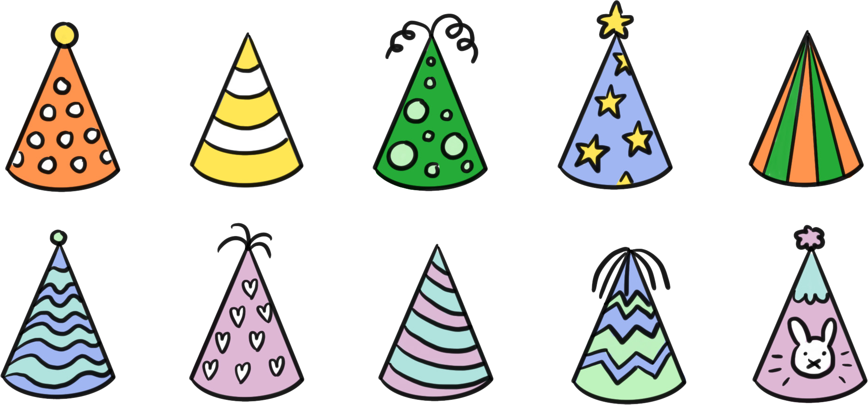
Frequency in a two-way table
Here are some party hats from a pack.
not striped
striped
topper
Some of them can be said to be striped.
Some of them can be said to have toppers.
We can sort them into an outcome table based on toppers and stripes.
no topper

Slide 31
Frequency in a two-way table
not striped
Rather than have the individual party hats, we can just focus on the frequency.
striped
topper
2
There are two party hats which are both striped and with a topper.
no topper
We can continue counting the frequencies to construct a frequency table

Slide 32
Frequency in a two-way table
not striped
striped
total
If we continue counting in this way, we end up with this frequency table
topper
2
4
6
no topper
3
1
4
total
5
5
10

Slide 33

Frequency in a two-way table
Alex is running a charity raffle. The tickets are either yellow, blue or pink and each has a 3 digit number on. He decides to consider the two events: that the ticket is yellow (Y), and that the ticket has an odd number.
He has partially completed this two-way table.
Is there enough information to complete it?
Y
not Y
total
odd
6
20
not odd (even)
Yes. The tickets are either ‘odd’ or ‘not odd’, which means the total of ‘odd’ (20) and the total of ‘not odd’ (19) gives the total number of tickets in the raffle (39).
13
19
total
39

Slide 34
Frequency in a two-way table
Alex is running a charity raffle. The tickets are either yellow, blue or pink and each has a 3 digit number on. He decides to consider the two events: that the ticket is yellow (Y), and that the ticket has an odd number.
He has partially completed this two-way table.
Is there enough information to complete it?
Y
not Y
total
odd
6
14
20
not odd (even)
Then we know there are a total of 20 ‘odd’ tickets of which 6 are ‘yellow’. So this means 14 ‘odd’ tickets are ‘not yellow’.
13
19
total
39

Slide 35
Frequency in a two-way table
Alex is running a charity raffle. The tickets are either yellow, blue or pink and each has a 3 digit number on. He decides to consider the two events: that the ticket is yellow (Y), and that the ticket has an odd number.
He has partially completed this two-way table.
Is there enough information to complete it?
Y
not Y
total
odd
6
14
20
not odd (even)
Similarly, there are 19 ‘not odd’ tickets and 13 are also ‘not yellow’, which means 6 of the ‘not odd’ cards are ‘yellow’.
6
13
19
total
39

Slide 36
Frequency in a two-way table
Alex is running a charity raffle. The tickets are either yellow, blue or pink and each has a 3 digit number on. He decides to consider the two events: that the ticket is yellow (Y), and that the ticket has an odd number.
He has partially completed this two-way table.
Is there enough information to complete it?
The order in which this two-way table was completed could be different.
If you know two values in any row or column you can find the third value.
The final value can always act as a self check by calculating it from both the row and column to check they match.
Y
not Y
total
odd
6
14
20
not odd (even)
Then, the total number of ‘yellow’ tickets can be calculated, and the total number of ‘not yellow’ tickets can be calculated.
6
13
19
total
12
27
39
Check they sum to the total total. 12 + 27 = 39 ✔

Slide 37
Frequency in a two-way table
Here is a partially completed two-way table regarding shoe size and year group in a school. Which of the entries can be calculated first?
The number of ‘year 9’ students with ‘not size 7’ feet.
a
size 7
not size 7
total
The total number of ‘year 9’ students.
year 9
64
b
not year 9
552
714
The number of ‘not year 9’ students who have ‘size 7’ feet.
c
total
601
d
The total number of students.

Slide 38
Frequency in a two-way table
1) A random sample of people is being selected by allocating an integer from 1 to 50 to each person and then picking based on two rules. Rule 1 is that the integer is a multiple of 10 and rule 2 is that the integer is a multiple of 4.
multiple of 10
not a multiple of 10
total
Complete the two-way table.
multiple of 4
not a multiple of 4
total
50

Slide 39

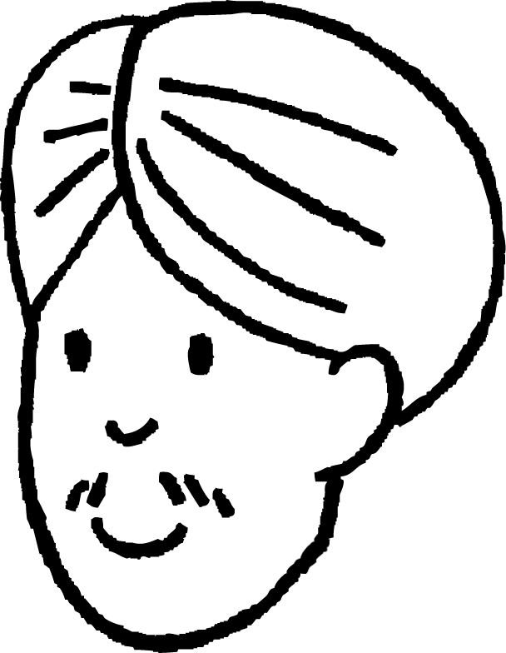
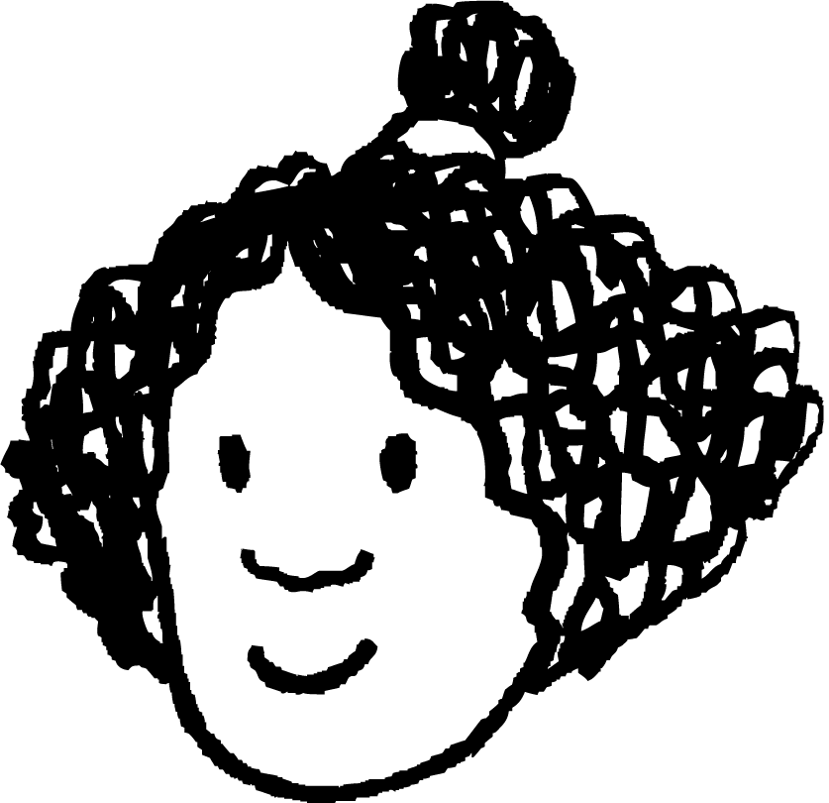
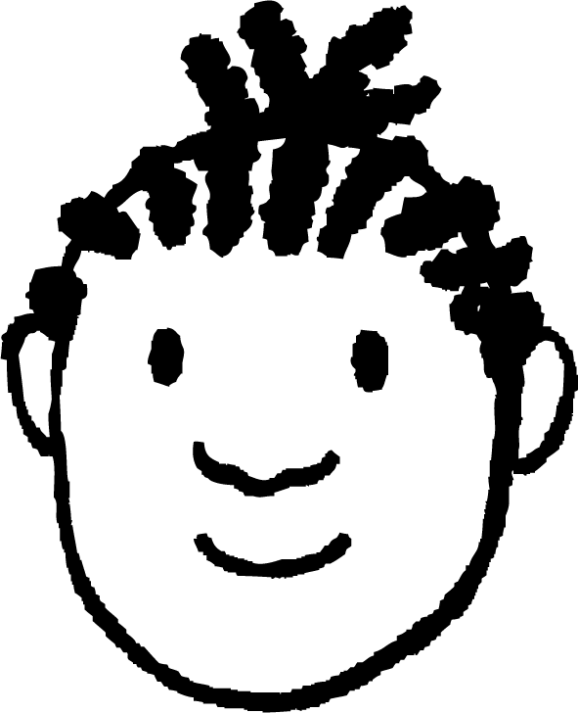



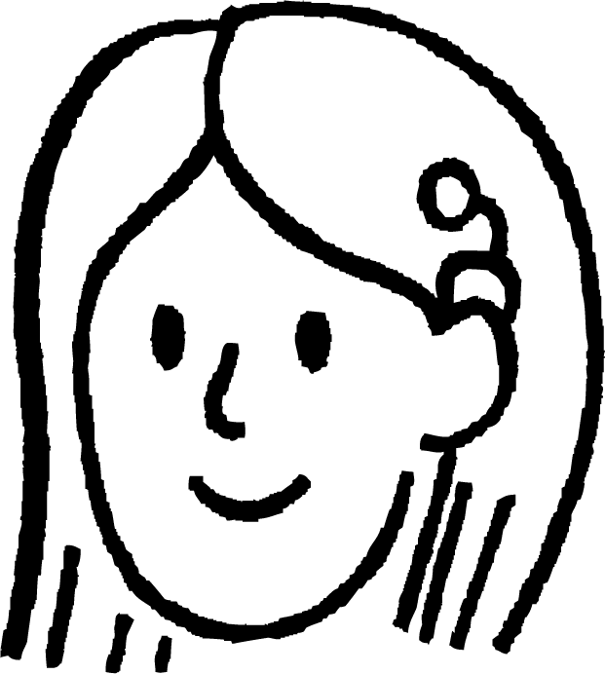
Frequency in a two-way table
10 pupils have been asked about whether they are members of a sports or music club.
2)
Aisha | Music | Sport
Andeep | Music
Izzy
Jacob | Sport
Jun | Music | Sport
Lucas | Music | Sport
Laura | Music
Sam | Music
Alex | Sport
Sofia | ? | ?
a) Circle all the numbers in the table that include Izzy.
b) Which clubs does Sofia do, if any?
sports club
no sports club
total
music club
3
4
7
no music club
2
1
3
total
5
5
10

Slide 40
Frequency in a two-way table
3)
Fill the missing boxes on each of these two-way tables.
a)
b)
 | 1st attempt | 2nd attempt | total
pass | 12
fail |  | 6 | 22
total |  | 16
 | child | adult | total
goggles |  |  | 23
no goggles |  | 31
total |  | 36 | 63

Slide 41
Frequency in a two-way table
1) A random sample of people is being selected by allocating an integer from 1 to 50 to each person and then picking based on two rules. Rule 1 is that the integer is a multiple of 10 and rule 2 is that the integer is a multiple of 4.
multiple of 10
not a multiple of 10
total
Complete the two-way table.
multiple of 4
2
10
12
not a multiple of 4
3
35
38
total
5
45
50

Slide 42
Frequency in a two-way table
10 pupils have been asked about whether they are members of a sports or music club.
2)
Aisha | Music | Sport
Andeep | Music
Izzy
Jacob | Sport
Jun | Music | Sport
Lucas | Music | Sport
Laura | Music
Sam | Music
Alex | Sport
Sofia | Music
a) Circle all the numbers in the table that include Izzy.
b) Which clubs does Sofia do, if any?
sports club
no sports club
total
music club
3
4
7
no music club
2
1
3
total
5
5
10

Slide 43
Frequency in a two-way table
3)
Fill the missing boxes on each of these two-way tables.
a)
b)
 | 1st attempt | 2nd attempt | total
pass | 12 | 10 | 22
fail | 16 | 6 | 22
total | 28 | 16 | 44
 | child | adult | total
goggles | 18 | 5 | 23
no goggles | 9 | 31 | 40
total | 27 | 36 | 63

Slide 44
Using two-way tables to display outcomes for two events
Outcomes can be listed in an outcome table.
For a two-stage trial, one stage is the columns the other the rows. The sample space is the outcomes shown within the grid. It is a systematic way to construct a sample space.
For two events from a trial, the sample space can be categorised by the events.
When frequencies are shown in a two way table it is possible to find missing values using totals for columns and rows.

Slide 45

© Oak National Academy 2024.
Produced in partnership with Mathematics in Education and Industry.
Licensed on the Open Government Licence v3.0, except where otherwise stated. See Oak terms and conditions.

